Slide 1



NE Hackathon: Introduction to the problem
Kartik Naik
Data Scientist
Powertrust

Slide 2
BACKGROUND
Distributed solar
Renewable Energy Certificates (RECs)
Three key parties:
SOLAR DEVELOPERS: Generate clean energy, get paid.
REC BUYERS: Pay for the energy, get credits/tax benefits
REC ISSUERS: Validate/Supervise process

Slide 3
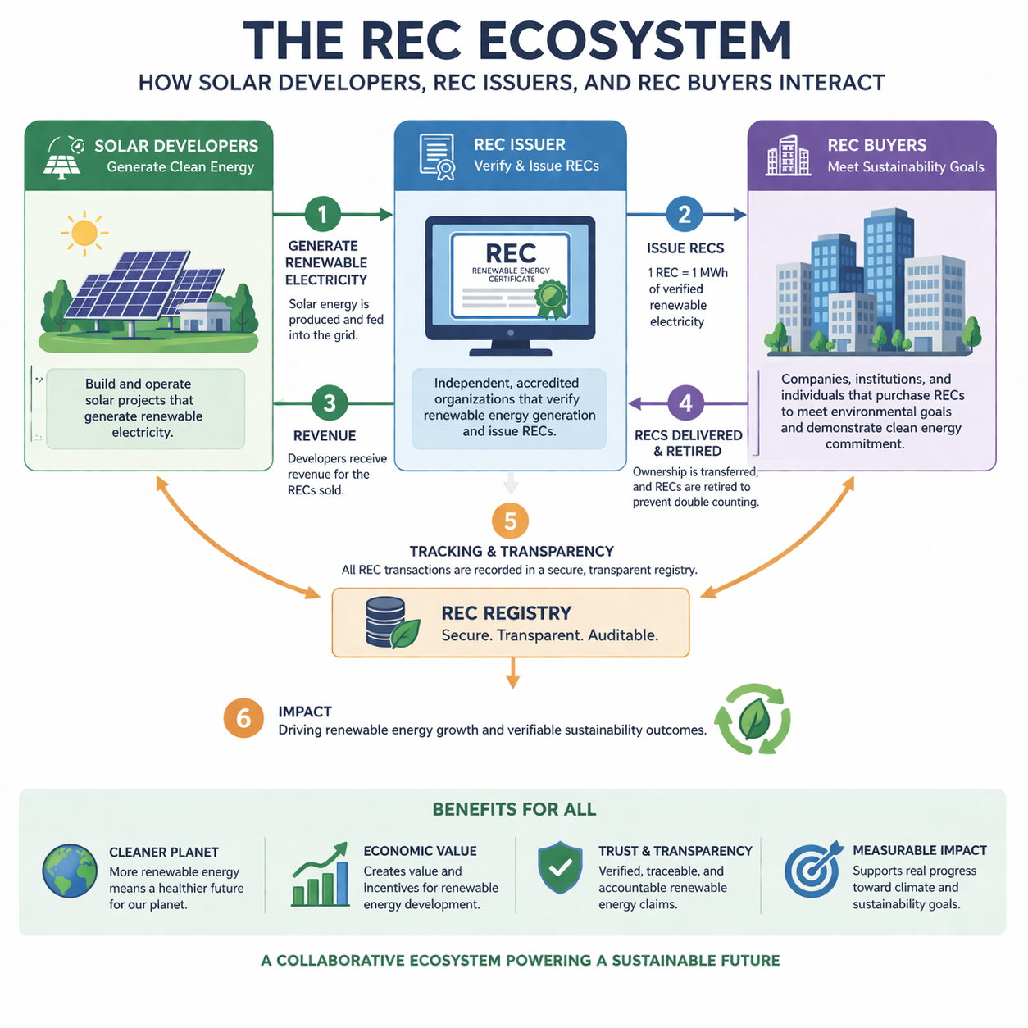
Notes:
Powertrust takes care of all operations 1-5, acting as an agency bring the ecosystem together

Slide 4
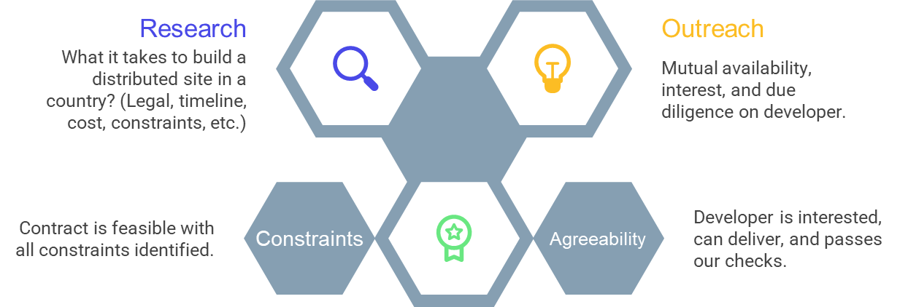
What it takes to contract with a site?

Slide 5
Questions to Address
Cost & Economics Estimate and/or benchmark:
CAPEX and O&M costs for distributed solar
Utility and grid charges
Comparative cost structures across generation types (e.g., small/large solar, wind, CCGT, gas)
Grid Access & Queue Dynamics
Average grid interconnection wait times
Regional variation in grid congestion or accessibility
Subsidies, Incentives & Policy Support
Net metering policies
Solar-specific subsidies, grants, or tax incentives
Utility Standards & Obligations
Renewable Portfolio Standards (RPS) or equivalent mandates
Utility obligations to procure renewable energy
Public Comment & Approval Signals
Key themes, objections, or concerns raised during project approval processes
Insights derived even from unstructured or incomplete records
Unknown Unknowns (Discovery Layer)
Surface country-specific risks or constraints not explicitly defined above
Examples may include energy access gaps, land-use conflicts, financing barriers, or regulatory bottlenecks
Key Point:
Understand distributions!
(e.g., State-wise, urban-rural)
Notes:
Choose a country
Understand and capture distributions

Slide 6
READY TO GO!
Immediate Next Steps
Main Outcome: Research Tool
Demo/presentation on April 14
Choose Country
Review Halcyon
Review provided example of data sources: India
Train chat model
Develop visual report
Visual interactive report
Chat for follow-up questions
Methodology for including other countries

